Slide 1

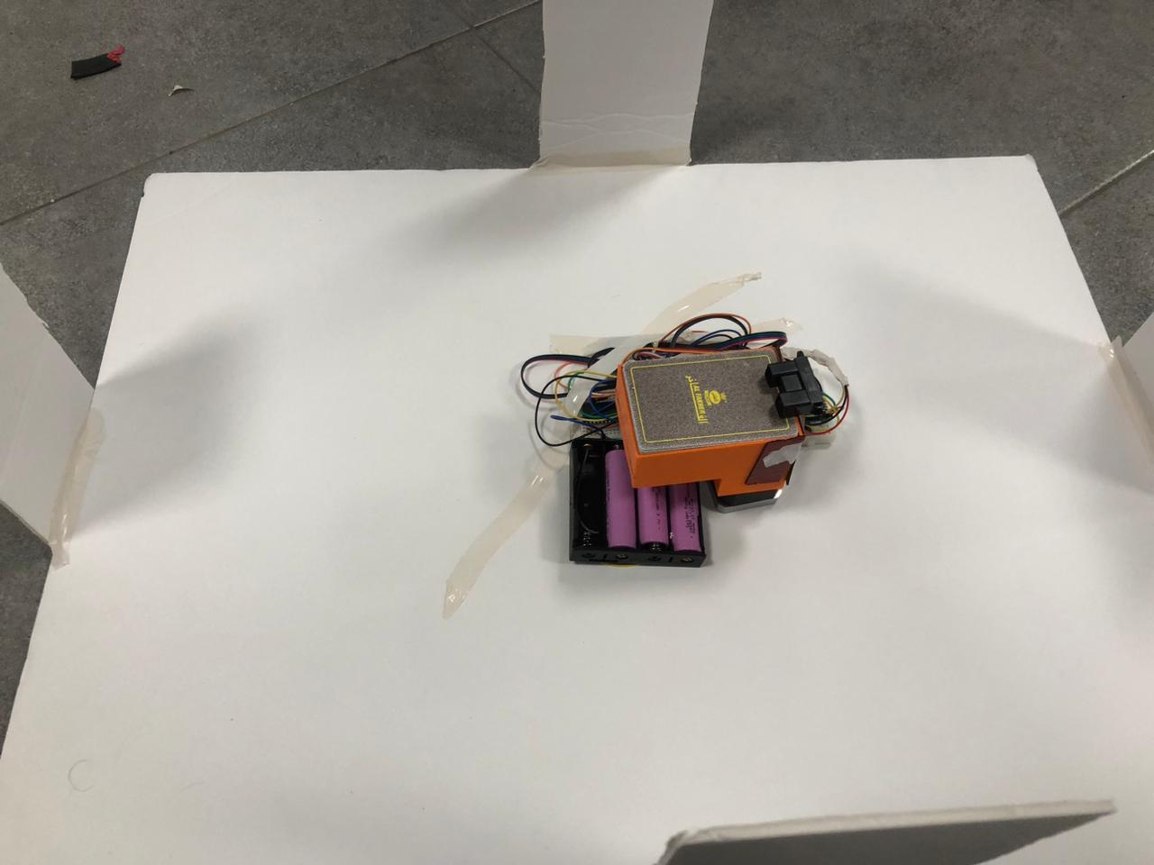
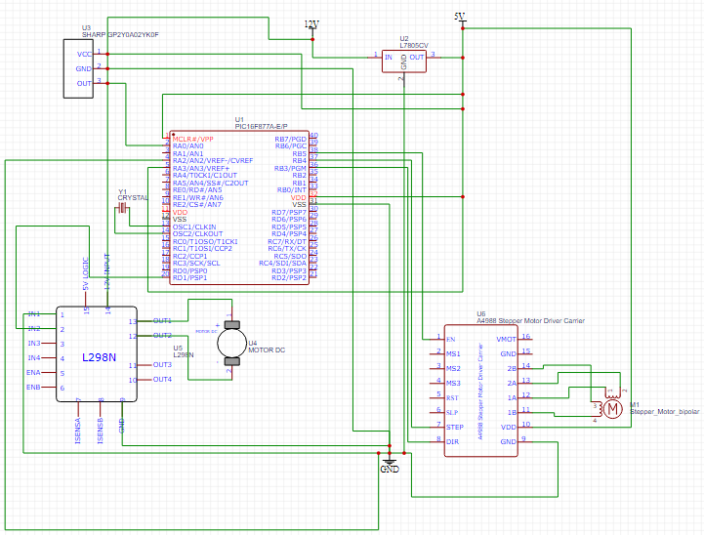
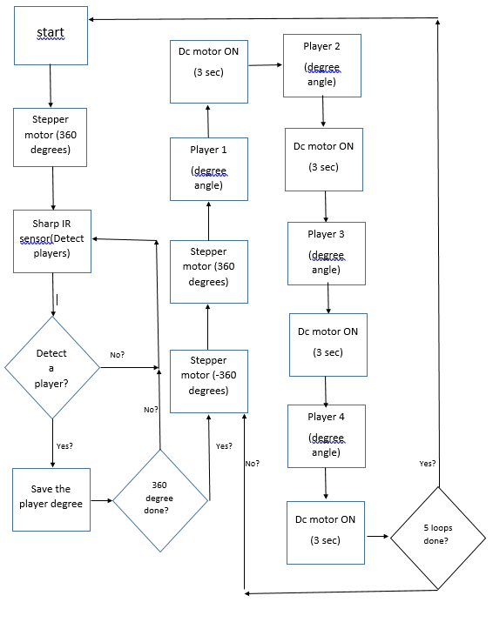
Automated Card Distribution
Basil Alsarayra
Supervisor: Dr. Belal Sababha
Embedded Systems Final Design Project, 2024
King Abdullah II School of Engineering
Princess Sumaya University for Technology
Introduction
This automated system aims to revolutionize traditional card game setups, providing a seamless and dynamic distribution process that eliminates the manual effort associated with handling and dealing cards. Beyond its functional aspects, the project reflects a commitment to innovation in gaming technology, enhancing user engagement and fostering an immersive gaming experience
In summary, the development of the Automated Card Distribution System using PIC 16F8778 marks a significant advancement in enhancing card game dynamics. Leveraging technologies like the Sharp IR sensor and stepper and dc motors, the system streamlines card distribution, offering a seamless and adaptable gaming experience.
Results
After assembling all the hardware and software components and installing them on the base with the game, we got our final product as shown in the pictures below:
Figure2 : Automated Card Distribution.
Figure3 : diagram
The Automated Card Distribution System operates through a systematic process facilitated by the Sharp IR sensor, stepper motor, and dc motor.
Initially, the stepper motor turns 360 degrees and detect players through the sharp IR sensor then turn back to the original point, then the stepper motor will turn another 360 degree and in each player is detected the dc motor will turn on to through the cards, this operation will repeat it self until all the cards are done
Design
Figure1 : Schematic design.
The stepper motor facilitates a 360-degree rotation of the cardholder, while the servomotor efficiently propels cards from the holder to the table.
The integration of the Sharp IR sensor ensures precise detection of the number of players and their positions, contributing to an accurate and dynamic card distribution process.
Conclusion
In summary, the development of the Automated Card Distribution System using PIC 16F8778 marks a significant advancement in enhancing card game dynamics. Leveraging technologies like the Sharp IR sensor and stepper and servomotors, the system streamlines card distribution, offering a seamless and adaptable gaming experience.
In essence, this project exemplifies the fusion of technology and gaming, showcasing how automation can enhance traditional experiences. The system promises to redefine card game dynamics, providing both convenience and a novel dimension to the enjoyment of playing cards.

